Slide 1

Missing Data & Multiple Imputation
www.cehs.usu.edu/research/statstudio
Dr. Sarah Schwartz
Spring 2021

Slide 2

https://rmc.ehe.osu.edu/files/2018/02/0.0-Workshop_missing-data-with-SPSS_Finalaudience.pdf

Slide 3
The importance of dealing with missing data
Rarely see a dataset that is complete and beautiful
Traditional techniques rely on strict assumption about missing data mechanisms (rarely be achieved in real world)
The problem of missing data:
Treat it inappropriately, obtain unreliable and biased estimates, make incorrect conclusion of results
Reduce the statistical power of your test to detect a significant effect (e.g., listwise deletion)

Slide 4
Missing Data
Reasons
longitudinal study
moved out of the area
died
no longer see personal benefit to participating
do not like the effects of the treatment
Survey
participants refuse
do not know the answer
accidentally skip an item
design the study so that some questions are asked of only a subset of participants
Experimental study
a researcher is simply unable to collect an observation
Bad weather conditions may render observation impossible in field experiments
Miscellaneous
researcher becomes sick
equipment
accidental or data entry error
drops a tray of test tubes
data file becomes corrupt

Slide 5
Missing Data
Why does it matter?
Missing data are problematic because most statistical procedures require a value for each variable. When a data set is incomplete, the data analyst has to decide how to deal with it.
The most common decision is to use complete case analysis (also called listwise deletion)–analyzing only the cases with complete data. Individuals with data missing on any variables are dropped from the analysis.
It has advantages–it is easy to use, is very simple, and is the default in most statistical packages. But it has limitations.
It can substantially lower the sample size, leading to a severe lack of power. This is especially true if there are many variables involved in the analysis, each with data missing for a few cases. It can also lead to biased results, depending on why the data are missing.

Slide 6

Missing Data Patterns

Slide 7
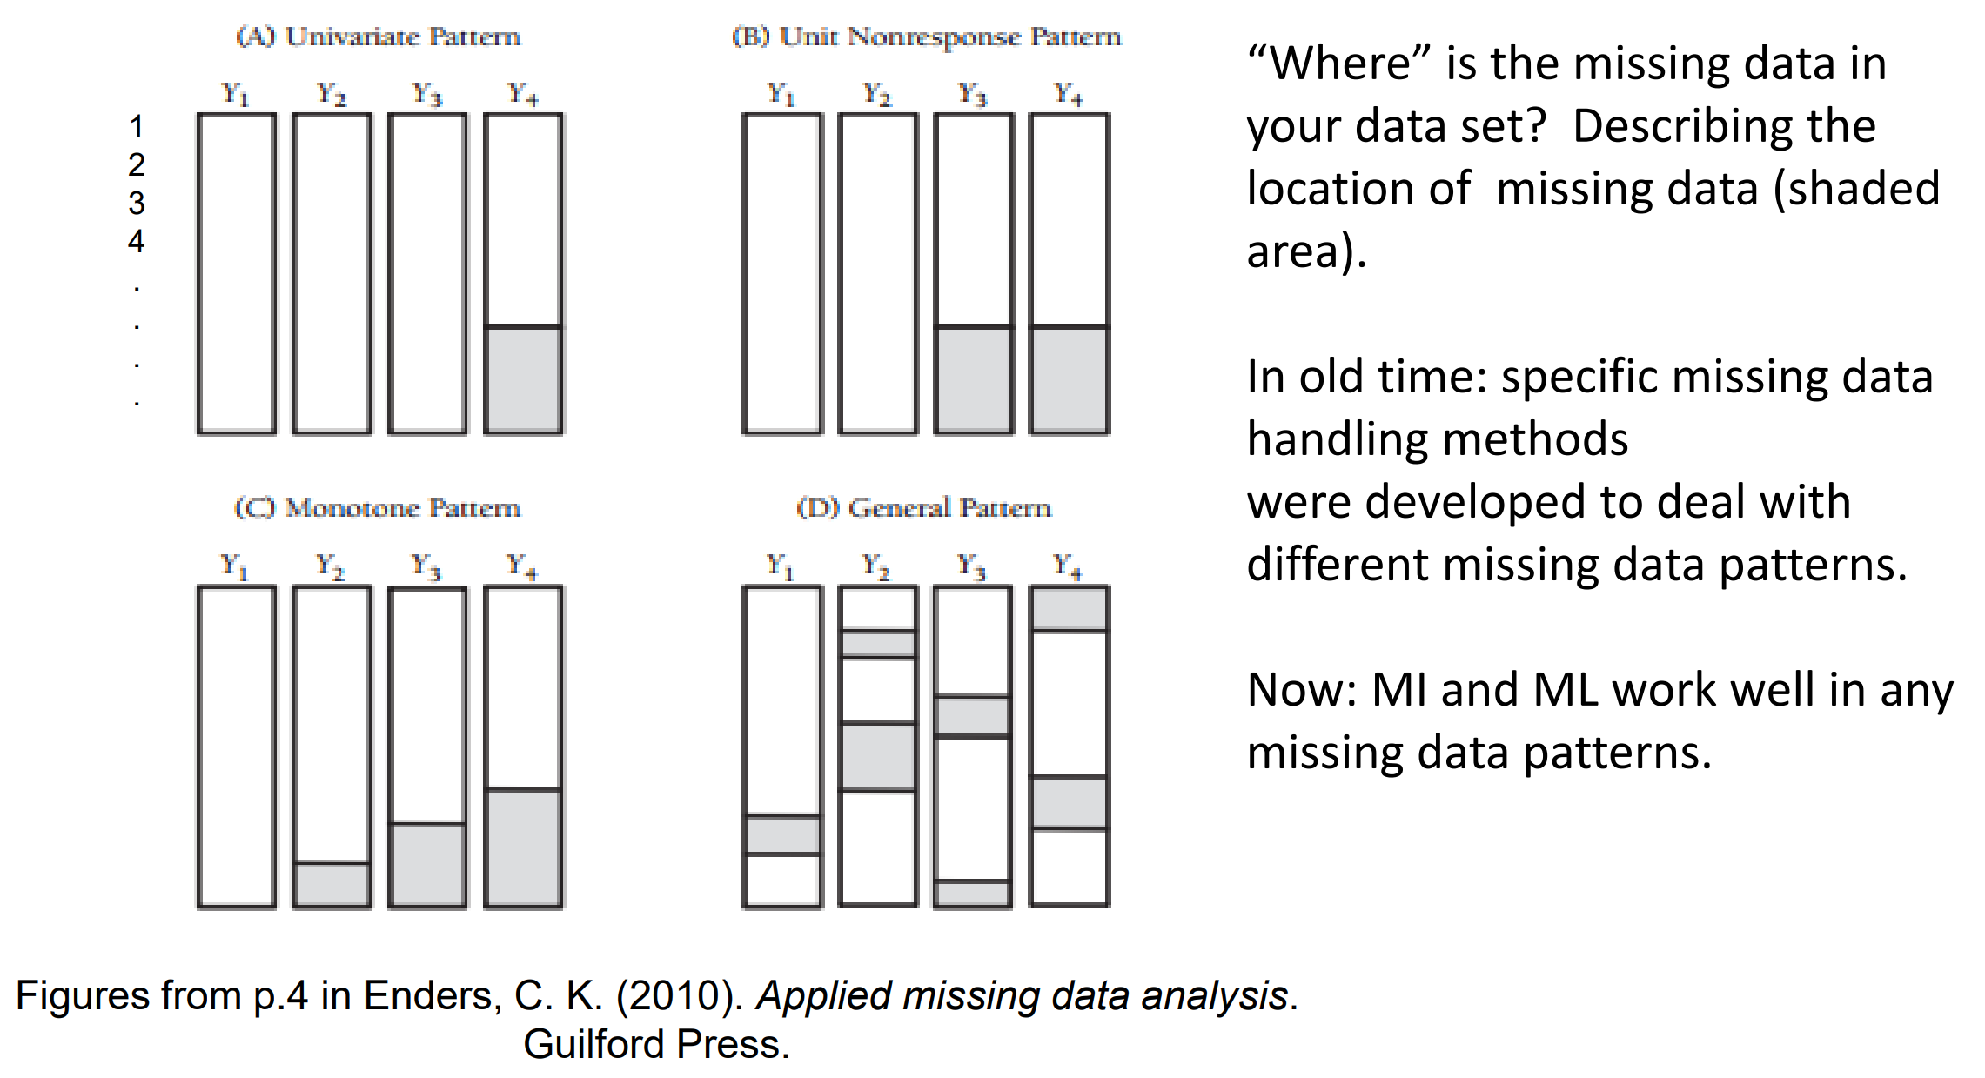
Missing Data: Prototypical Patterns

Slide 8
Why are the data missing?
Pattern, Percentage, Mechanism
“Missing data mechanisms describe the relationships between measured variables and the probability of missing data and essentially function as assumptions for missing data analysis (Enders, 2010, p.2).”
Why are data missing? …possible explanation for missing data and find evidence to justify our claim.
Missing data mechanisms are much important than percentage of missing
Percentage of missing is to know the scope of missing data problem
It governs the performance of different analytic techniques

Slide 9
Missing Data Mechanisms

Slide 10
Missing Data Mechanisms
YouTube Video (6 min)
MCAR, MAR, NMAR
User ID | Missing | Income | Likelihood to Recommend | Favorability toward the Brand | Likelihood to Repurchase
1 | 1 |  | 4 | 4 | 5
2 | 0 | 50k-74k | 8 | 6 | 7
3 | 0 | 50k-74k | 9 | 6 | 7
4 | 0 | 100k+ | 10 | 7 | 7
5 | 0 | 50k-74k | 8 | 5 | 4
6 | 0 | 25-49k | 7 | 1 | 2
7 | 0 | 25-49k | 8 | 5 | 6
8 | 1 |  | 6 | 5 | 5
9 | 0 | 25-49k | 4 | 4 | 4

Slide 11

Missing Data Mechanisms
Relationship between missing values & observed values
MCAR = Missing Completely at Random
MAR = Missing at Random
MNAR = Missing Not at Random
Missing Status is INDEPENDENT of Observed Values & Missing Values of all Variables
Missing Status is Conditional on Observed Values
of Other Variables
Missing Status is Conditional on UnknownValues
of the Missing Variable

Slide 12
Missing Data Mechanisms
Missing Completely At Random (MCAR)
The missing data mechanism is unrelated to the values of any variables, whether missing or observed.
Most restrictive mechanism.
If the observed values are essentially a random sample of the full data set, complete case analysis gives the same results as the full data set would have.
Unfortunately, most missing data are not MCAR.
Ex) Data that are missing because a researcher dropped the test tubes or survey participants accidentally skipped questions are likely to be MCAR.
Ex) Children’s test scores are missing due to a funeral, family vacation, dentist appointment, …

Slide 13
Missing Data Mechanisms
Missing Not at Random (MNAR)…or Non-Ignorable (NI)
There is a relationship between the propensity of a value to be missing and its values.
It commonly occurs when people do not want to reveal something very personal or unpopular about themselves.
Complete case analysis can give highly biased results for MNAR missing data You have to include some model for why the data are missing and what the likely values are
Ex) Individuals with higher incomes are less likely to reveal them on a survey than are individuals with lower incomes, the missing data mechanism for income is non-ignorable. Whether income is missing or observed is related to its value.
Ex) If proportionally more low and moderate income individuals are left in the sample because high income people are missing, an estimate of the mean income will be lower than the actual population mean.
Ex) Hispanic children with lower reading scores are more likely to be missing

Slide 14
Missing Data Mechanisms
No way to directly test… but it’s the basic assumption for ML or MI
Missing At Random (MAR)
Requires that the cause of the missing data is unrelated to the missing values …BUT the missing values are related to observed values on other variables
There is a systematic relationship between the propensity of missing values and the observed data, but not the missing data.
Ex) Missing income data may be unrelated to the actual income values but are related to education. Perhaps people with more education are less likely to reveal their income than those with less education.
Ex) men are more likely to tell you their weight than women

Slide 15
Missing Data Mechanisms
IQ | Job | MCAR | MAR | MNAR
78 | 9 | --- | --- | 9
84 | 13 | 13 | --- | 13
84 | 10 | --- | --- | 10
85 | 8 | 8 | --- | ---
87 | 7 | 7 | --- | ---
91 | 7 | 7 | 7 | ---
92 | 9 | 9 | 9 | 9
94 | 9 | 9 | 9 | 9
94 | 11 | 11 | 11 | 11
96 | 7 | --- | 7 | ---
99 | 7 | 7 | 7 | ---
105 | 10 | 10 | 10 | 10
105 | 11 | 11 | 11 | 11
106 | 15 | 15 | 15 | 15
108 | 10 | 10 | 10 | 10
112 | 10 | 10 | 10 | 10
113 | 12 | --- | 12 | 12
115 | 14 | 14 | 14 | 14
118 | 16 | 16 | 16 | 16
134 | 12 | --- | 12 | 12
Job Performance Ratings

Slide 16
Diagnosing the Mechanism
MAR vs. MNAR
The only true way to distinguish between MNAR and MAR is to measure some of that missing data. It’s a common practice among professional surveyors to, for example, follow-up on a paper survey with phone calls to a group of the non-respondents and ask a few key survey items. This allows you to compare respondents to non-respondents.
If their responses on those key items differ by very much, that’s good evidence that the data are MNAR.
However in most missing data situations, we don’t have the luxury of getting a hold of the missing data. So while we can’t test it directly, we can examine patterns in the data get an idea of what’s the most likely mechanism.
The first thing in diagnosing randomness of the missing data is to use your substantive scientific knowledge of the data and your field. The more sensitive the issue, the less likely people are to tell you. They’re not going to tell you as much about their cocaine usage as they are about their phone usage.
Likewise, many fields have common research situations in which non-ignorable data is common. Educate yourself in your field’s literature.

Slide 17
Diagnosing the Mechanism
MCAR vs. MAR
There is a very useful test for MCAR, Little’s test. But like all tests of assumptions, it’s not definitive. So run it, but use it as only one piece of information.
A second technique is to create dummy variables for whether a variable is missing.
1 = missing, 0 = observed
You can then run t-tests and chi-square tests between this variable and other variables in the data set to see if the missingness on this variable is related to the values of other variables.
Ex) If women really are less likely to tell you their weight than men, a chi-square test will tell you that the percentage of missing data on the weight variable is higher for women than men.

Slide 18
Missing Data Indicator
IQ | Job Truth | Job Obs | `R`
78 | 9 |  | 0
84 | 13 |  | 0
84 | 10 |  | 0
85 | 8 |  | 0
87 | 7 |  | 0
91 | 7 | 7 | 1
92 | 9 | 9 | 1
94 | 9 | 9 | 1
94 | 11 | 11 | 1
96 | 7 | 7 | 1
99 | 7 | 7 | 1
105 | 10 | 10 | 1
105 | 11 | 11 | 1
106 | 15 | 15 | 1
108 | 10 | 10 | 1
112 | 10 | 10 | 1
113 | 12 | 12 | 1
115 | 14 | 14 | 1
118 | 16 | 16 | 1
134 | 12 | 12 | 1
MAR

Slide 19
Missing Data
Race: complete observed
DV: missing for some students
R: missing data indicator
Introduced by Rubin (1976)
Race | DV = Reading | R
Asian |  | 0
Asian |  | 0
Caucasian |  | 0
Asian |  | 0
Asian |  | 0
Caucasian | 66 | 1
Caucasian | 88 | 1
Caucasian | 95 | 1
Caucasian | 100 | 1
Asian | 86 | 1
Asian | 56 | 1
Caucasian | 78 | 1
Whether the probability of missing data on a variable (R) is related to other variables in the dataset?
The relationship between probability of missingness and other variables in the dataset is then used to determine the missing data mechanisms.

Slide 20
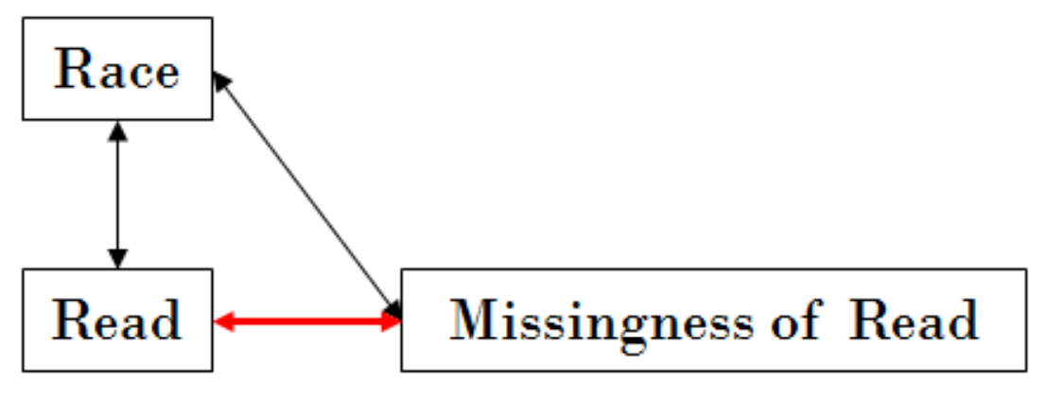
Missing Data Mechanisms
Missing Not at Random (MNAR)…or Non-Ignorable (NI)
“The probability of missing data on a variable Y is related to the values of Y itself, even after controlling for other variables (Enders, 2010, p.8).”
There is no way to verify whether data is MNAR without knowing the actual values of Y.
In some situation, you may have some sense about the actual values if you are in the field monitoring data collection process.
Needs to use other techniques to handle missing data: not ML or MI
IV = Race | DV = Reading | R
Asian |  | 0
Asian |  | 0
Caucasian |  | 0
Asian |  | 0
Asian |  | 0
Caucasian | 66 | 1
Caucasian | 88 | 1
Caucasian | 95 | 1
Caucasian | 100 | 1
Asian | 86 | 1
Asian | 56 | 1
Caucasian | 78 | 1

Slide 21
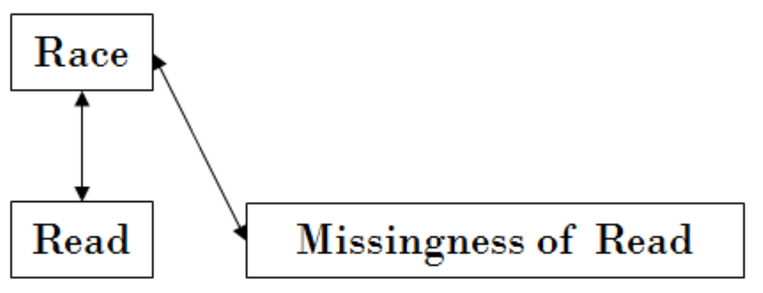
Missing Data Mechanisms
Missing at Random (MAR)
“The probability of missing data on a variable Y is related to some other measured variable(s), but not to the values of Y itself (Enders, 2010, p.6).”
Because we do not know the actual value of Y…
Theoretical judgement about MAR by providing evidence.
ML and MI assume MAR
IV = Race | DV = Reading | R
Asian |  | 0
Asian |  | 0
Caucasian |  | 0
Asian |  | 0
Asian |  | 0
Caucasian | 66 | 1
Caucasian | 88 | 1
Caucasian | 95 | 1
Caucasian | 100 | 1
Asian | 86 | 1
Asian | 56 | 1
Caucasian | 78 | 1

Slide 22
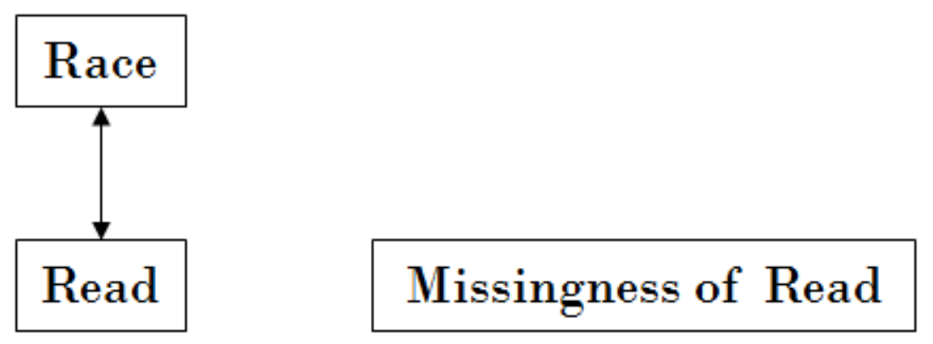
Missing Data Mechanisms
Missing Completely At Random (MCAR)
“The probability of missing data on a variable Y is unrelated to other measured variables and is unrelated to the values of Y itself (Enders, 2010, p.7).”
Observed data are just a simple random sample of the hypothetically complete dataset.
Find some evidence for MCAR.
For example, comparing cases with missing and without missing of a variable on other measured variables, two groups should not have differences!
IV = Race | DV = Reading | R
Asian |  | 0
Asian |  | 0
Caucasian |  | 0
Asian |  | 0
Asian |  | 0
Caucasian | 66 | 1
Caucasian | 88 | 1
Caucasian | 95 | 1
Caucasian | 100 | 1
Asian | 86 | 1
Asian | 56 | 1
Caucasian | 78 | 1

Slide 23
Finding evidence for MCAR or MAR:
t-test: R vs. other variables
Preforming a series of independent sample t-test to compare a group with missing and a group without missing on the mean of other variables in the dataset (categorical data, chi-square).
No sig difference implies MCAR
A sig difference implies MAR (good thing!)
A good way to identify variables that is related to missing’ness, which can be used in MI (provide information to impute missing value)
IV = Race | DV = Reading | R
Asian |  | 0
Asian |  | 0
Caucasian |  | 0
Asian |  | 0
Asian |  | 0
Caucasian | 66 | 1
Caucasian | 88 | 1
Caucasian | 95 | 1
Caucasian | 100 | 1
Asian | 86 | 1
Asian | 56 | 1
Caucasian | 78 | 1

Slide 24
Testing the MCAR
Little (1998)’s MCAR Test
Multivariate extension of the t-test approach
perform all t-tests simultaneously
A global test of MCAR
available in SPSS Missing Values Analysis module ($$$) under EM procedure
available in R with the `LittleMCAR()` function in the `BaylorEdPsych` package
Testing the Null hypothesis: the data is MCAR.
Significant MCAR test and/or significant t-tests = an indication of MAR.
Issues:
(1) Do not identify variables that violate MCAR.
(2) Low statistical power (type II error) when the number of variables that violate MCAR is small or weak relationship between missing’ness and data.

Slide 25
Methods for Handling Missing Data

Slide 26
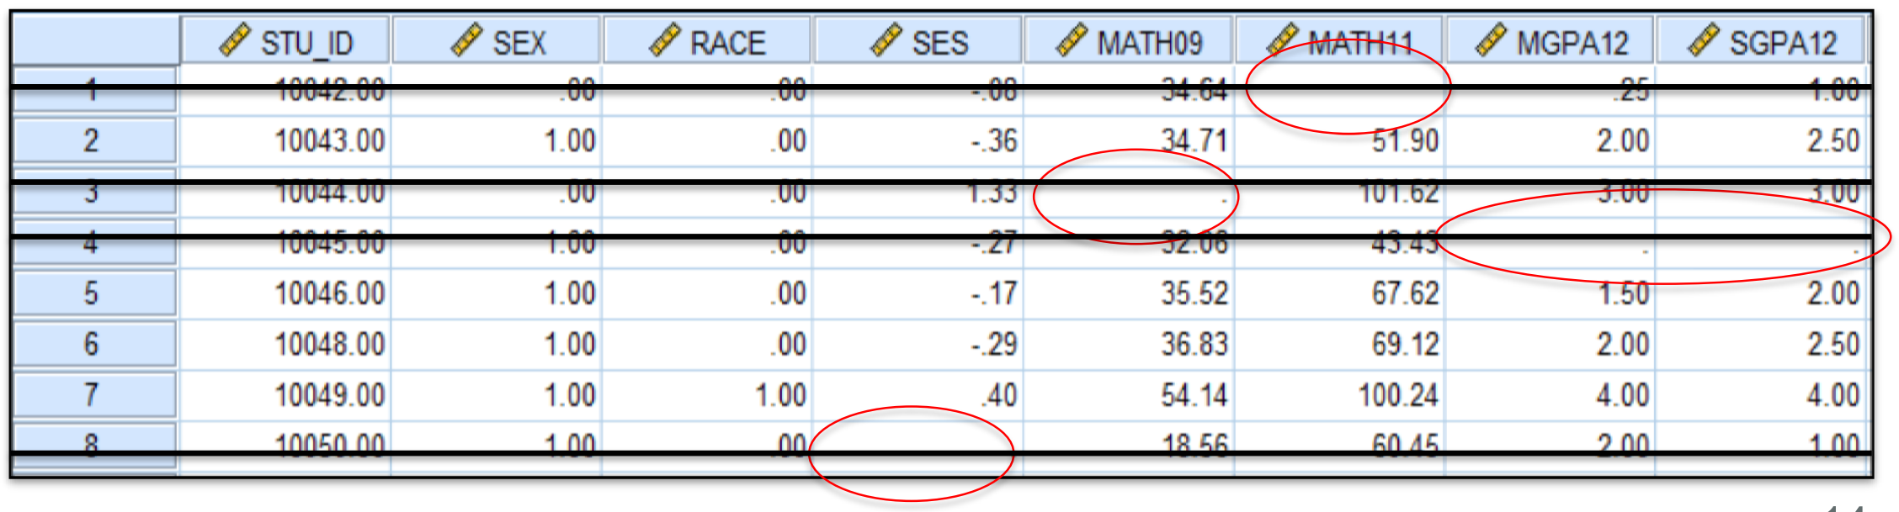
Methods for Handling Missing Data
Deletion Methods
Listwise Deletion (complete cases anlaysis)
If a case has missing data for any of the variables, then simply exclude that case from the analysis.
It is usually the default in statistical packages. (Briggs et al.,2003).
In this case, rows containing missing variables are deleted or ignored
Easy, convenient, available in all statistical software
Waste data and resources
Reduce sample size and statistical power
Assume MCAR (otherwise produce biased estimates)

Slide 27
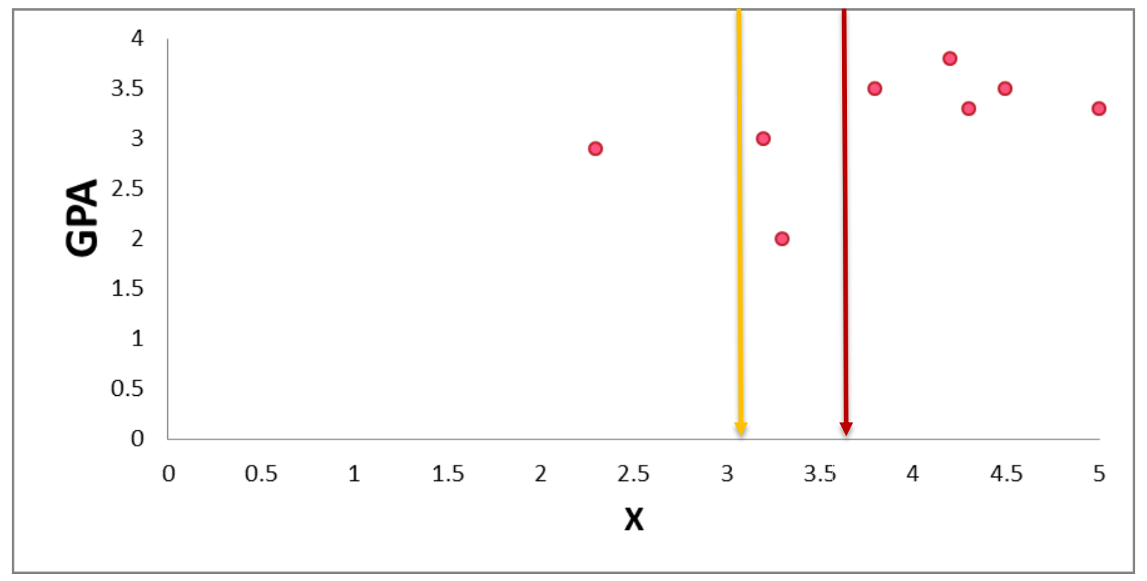
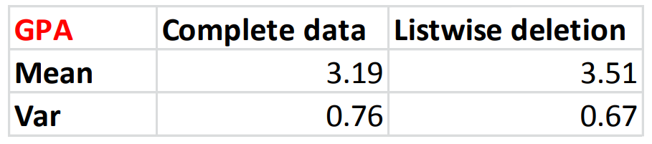
Methods for Handling Missing Data
Assume MAR for this example data
Deletion Methods
Listwise Deletion (complete cases anlaysis)
Problems :
1. The remaining cases do not represent the entire sample well
2. Higher mean estimate
3. Reduce the variability of data

Slide 28
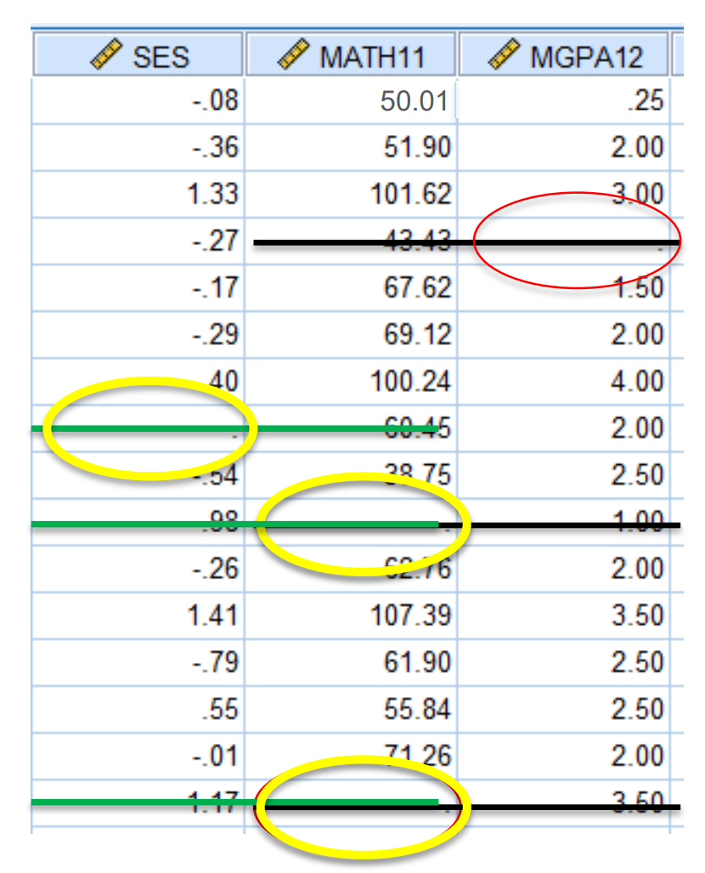

Methods for Handling Missing Data
Deletion Methods
Pairwise Deletion
Analysis with all cases in which the variables of interest are present.
Only the missing observations are ignored and analysis is done on variables present.
Analyses (e.g., correlation, regression) are conducted based on different subset of cases
Assume MCAR
Correlation:
Estimation problem: r >1 or < -1
Lack of consistent sample size: using different subsets of cases to estimate parameters, difficult to compute standard errors
$$r= \frac{σ_{XY}}{\sqrt{σ_{X}^{2}σ_{Y}^{2}}}$$

Slide 29
Methods for Handling Missing Data
Single Imputation Methods
Popular Averaging Techniques
Mean, median and mode are the most popular averaging techniques, which are used to infer missing values
Approaches ranging from global average for the variable to averages based on groups are usually considered
On simply way Replace missing value with sample mean or mode
Conditional Mean Imputation
Suppose we are estimating a regression model with multiple independent variables.
One of them, X, has missing values
We select those cases with complete information and regress X on all the other independent variables
Then, we use the estimated equation to predict X for those cases it is missing. (Graham, 2009) (Allison, 2001) and (Briggs et al., 2003)

Slide 30
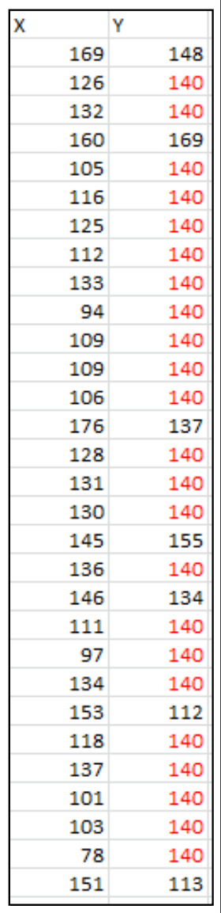
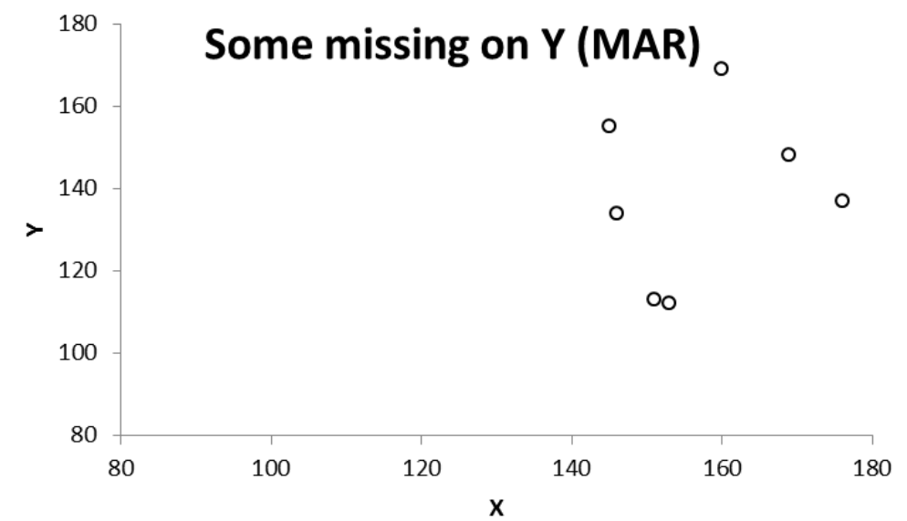
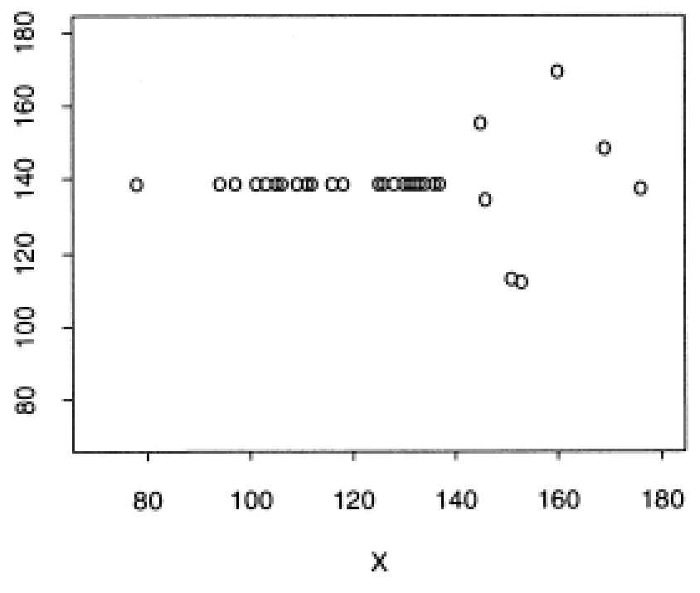
Methods for Handling Missing Data
Single Imputation Methods
Arithmetic Mean Imputation
mean substitution
using the mean of the available cases to fill in the missing value
Y has some missing , replace the missing value for Y with the mean of Y calculated from cases without missing on Y
Reduce variability of the data and correlations
Severely bias the parameter estimate, even MCAR

Slide 31
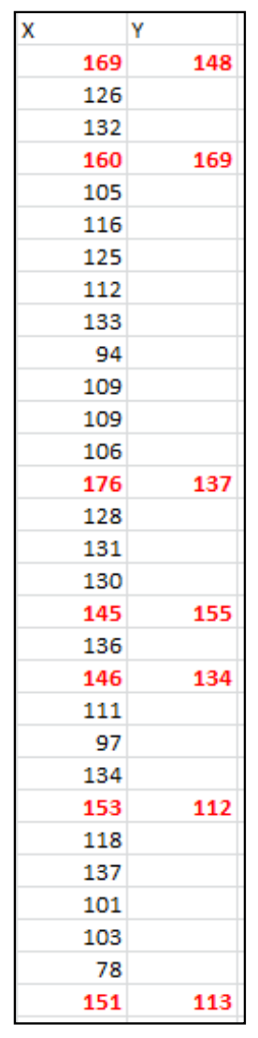
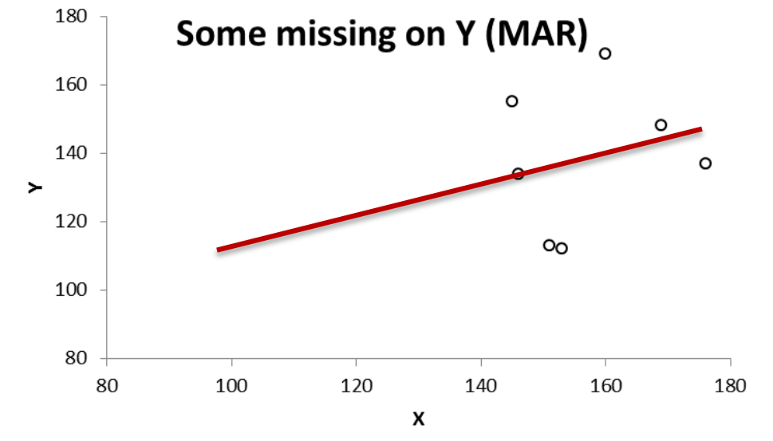
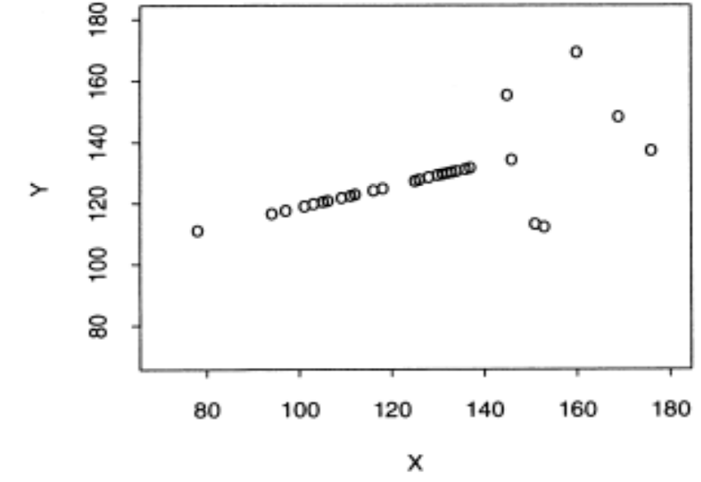

Methods for Handling Missing Data
Single Imputation Methods
Regression Imputation
conditional mean imputation
Predicted score of:
Reduce variability
overestimate correlations between variables and 𝑅 2 , even MCAR
$$Y_{i}^{∗}= \hat{β_{0}}+\hat{β_{1}}X$$

Slide 32
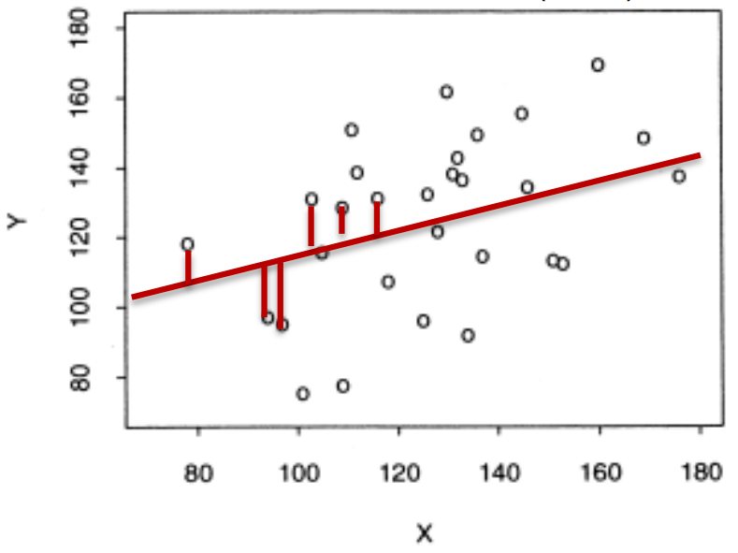
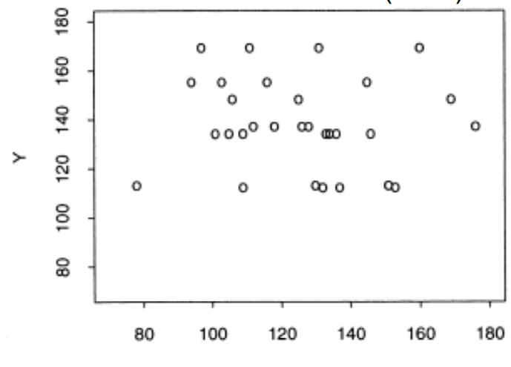
Methods for Handling Missing Data
Single Imputation Methods
Hot-deck Imputation
impute the missing values from “similar” respondents
Reduce variability to some extent, produce biases on correlation estimates and regression coefficients.
Stochastic Regression Imputation
conditional mean imputation + noise
Adding residual terms to the predicted values: restore the variability to the imputed data and eliminate biases.
Provide unbiased estimates under MAR just like ML and MI! But…attenuate the standard error, inflate type I error rate.

Slide 33
Special Situation
Multiple-item Questionnaire
Averaging the available items
Person-mean substitution
Researchers typically compute a scale score by summing or averaging the item responses that measure the same construct.
For example:
5 items measuring well-being
respondent answered 3 items but not all of the items
her/his scale score would be the average of those 3 items.
Potential problem :
Cronbach’s alpha is incorrect
may bias the variance and correlation
Use with caution, especially with high rate of item nonresponses.
ML and MI are better approaches.

Slide 34
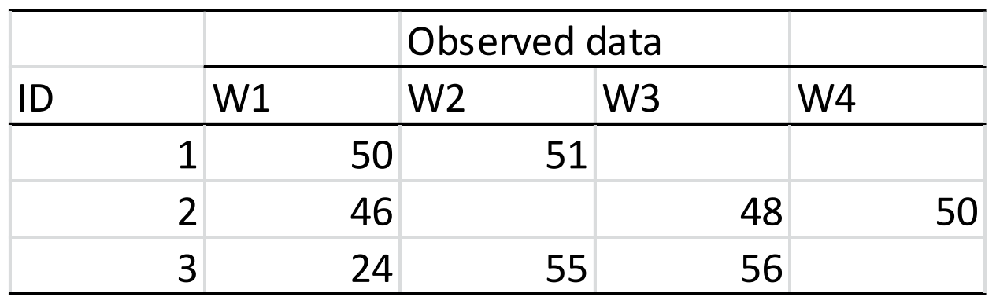
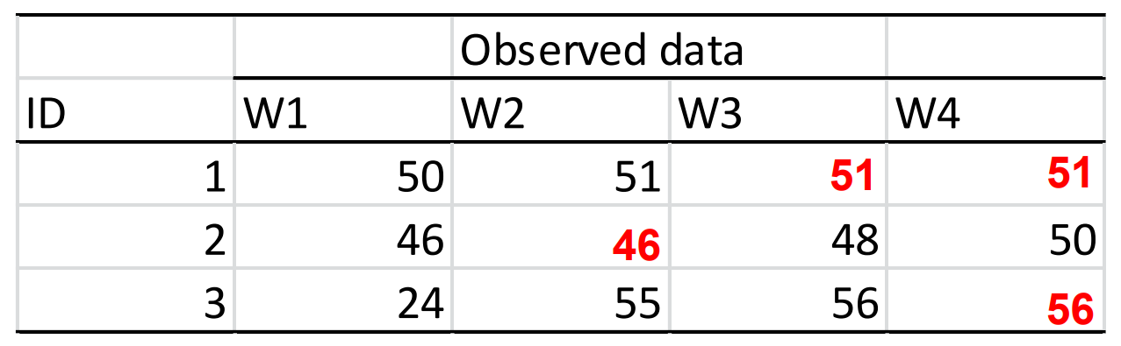
Special Situation
Repeated Measures, Longitudinal Design
Last observation carried forward
Replace the missing value with the observation that immediately before dropout.
Assume the scores do not change from the previous measurement.
Likely to produce biased estimate, even when data are MCAR.

Slide 35
Methods for Handling Missing Data
These are the BEST!!!
Model-based Methods
Maximum Likelihood (FIML)
We can use this method to get the variance-covariance matrix for the variables in the model based on all the available data points, and then use the obtained variance- covariance matrix to estimate our regression model (Schafer, 1997).
Estimate: value that is most likely to have resulted in the observed data.
Multiple Imputation
The imputed values are draws from a distribution, so they inherently contain some variation.
Thus, multiple imputation (MI) solves the limitations of single imputation by introducing an additional form of error based on variation in the parameter estimates across the imputation, which is called “between imputation error”.
It replaces each missing item with two or more acceptable values, representing a distribution of possibilities (Allison, 2001).

Slide 36
Methods for Handling Missing Data
Why FIML or Multiple imputation (MI)?
Traditional methods have its own limitation and some of them have strict assumption about missing data mechanisms.
Provides you with better and more trustworthy parameter estimates.
Make the conclusion about your statistical test more appropriately.
Allow you to have rigor on your study.

Slide 37
Full Information Maximum Likelihood

Slide 38
Full Information Maximum Likelihood (FIML)
Assume MAR and multivariate normality data
Implemented in structural equation modeling program such as Mplus (default) when the outcome is continuous
When used in the missing data context, using all the information in the dataset to directly estimate the parameters and standard errors; handling missing data in one-step
Does not drop any cases with missing values
Does not produce imputed datasets
FIML reads in the raw data of one case at a time,
and maximizes the ML function for one case at a time

Slide 39
Full Information Maximum Likelihood (FIML)
Assume MAR and multivariate normality data
“The computations for a case use the information only from the variables and the corresponding parameters for which the case has complete data. (Enders, 2010, p.89)”
Implies: depending on the missing data pattern for that case, the computations differ slightly (the ML function is customized to different missing data pattern).
Involving iterative processes, each time using different estimates of the parameters, until it finds a set of parameter values that maximize the likelihood function (Enders, 2010).
i.e., maximize the probability of observing the data, find a model that best fit the data.
ML converges: The parameter estimates no longer change across successive iterations.

Slide 40
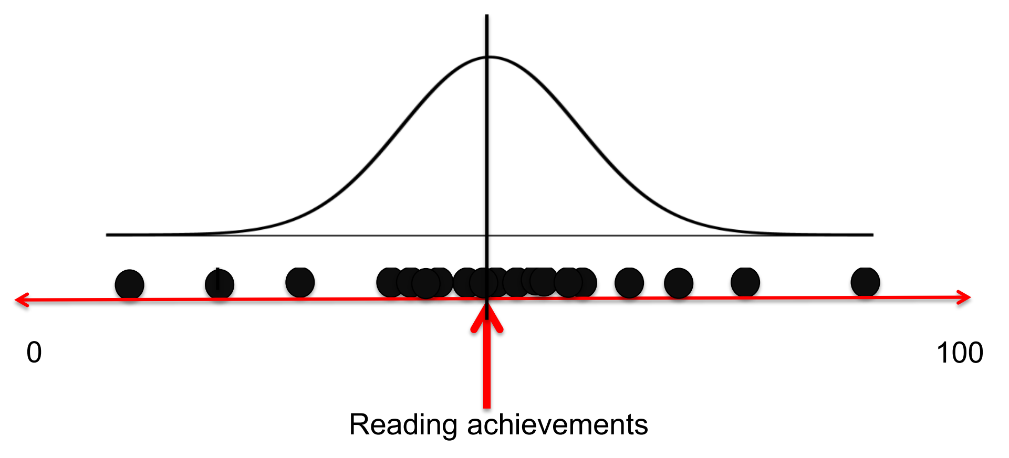
Full Information Maximum Likelihood (FIML)
Assume MAR and multivariate normality data
An iterative process: putting the distribution in all possible locations until the program finds a place where the distribution with a set of parameters that best fit the data (have the highest probability /likelihood of observing the data).

Slide 41
Multiple Imputation Method

Slide 42
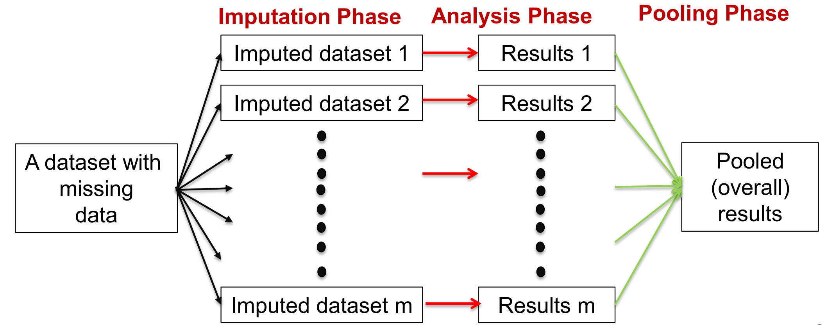
Multiple Imputation Method
Assume MAR and multivariate normality data
Assume MAR, also called multiple stochastic regression imputation (iterative procedure).
Available in Mplus, SAS, Stata, Blimp, SPSS (add on $$$), R and other.
Involves three steps:

Slide 43
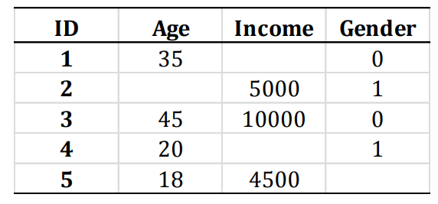
Multiple Imputation Method
1. Imputation Phase
multivariate imputation by chained equations (MICE)
a Markov Chain Monte Carlo algorithm
Does not rely on the assumption of multivariate normality.
Flexible in handling different types of variables.
Scale: linear regression
Categorical: logistic regression
Specify the imputation model on a variable-by-variable basis.
For each variable with missing data, a univariate (single dependent variable) imputation model is fitted using all other available variables in the model as predictors, then imputes missing values for the variable being fit

Slide 44
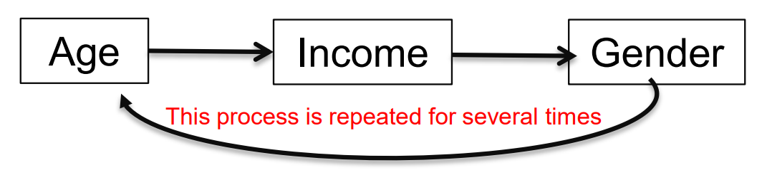
Multiple Imputation Method
1. Imputation Phase
The imputation process goes through all variables with missing value iteratively, every time with new/updated imputed values.
When the maximum number of iterations is reached (specified by researchers or by default), the imputed values at the maximum iteration are saved (one imputed dataset is created).

Slide 45
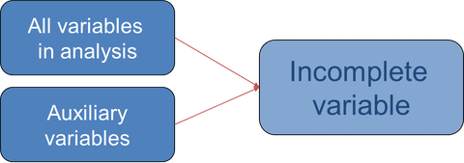
Multiple Imputation Method
1. Imputation Phase
What variables should be included in the imputation model?
(1) “At least” the variables that you are going to use in the subsequent analysis should be included.
Ex) For the goal to run a regression model and use gender & SES to predict freshman’s GPA. Gender, SES, and GPA should be included in the imputation model.
(2) Include auxiliary variables: “variables are either correlates of missingness or correlates of an incomplete variable” (Enders, 2010, p.17); these variables may not the study interest, but help improving the imputation quality and increasing the “plausibility of MAR”.
Ex) there are other variables such as parents’ education level, ACT, SAT, and other variables in the datasets which are correlated with variables of interest or their missingness.

Slide 46
Multiple Imputation Method
1. Imputation Phase
How many imputed datasets are needed?
There are strong associations between statistical power and number of imputations.
Convention wisdom: 3-5 imputed datasets; however, study showed that with only 3 or 5 imputed datasets, the power is below its optimal level (Graham et al., 2007).
According to Enders (2011), “generating a minimum of 20 imputed datasets seems to be a good rule of thumb for many situations“.
If the proportion of missing data is > 50% , increasing the # of imputations > 40 and be thoughtful about the variables included in the imputation model.

Slide 47
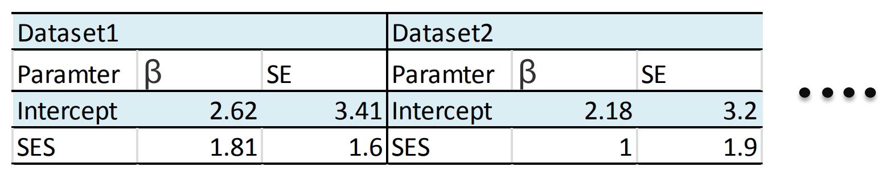
Multiple Imputation Method
2. Analysis Phase
Run the same analysis on EACH of the dataset
The imputation phase generate m set of imputed datasets.
The analysis phase: analyze the imputed datasets using the normal analysis procedure.
Ex) a researcher generates 20 datasets and now would like to use multiple regression to analyze the data. She/he will repeat multiple regression analysis 20 times, one analysis for each of the datasets.

Slide 48
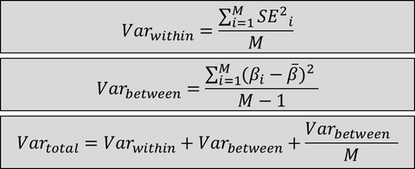
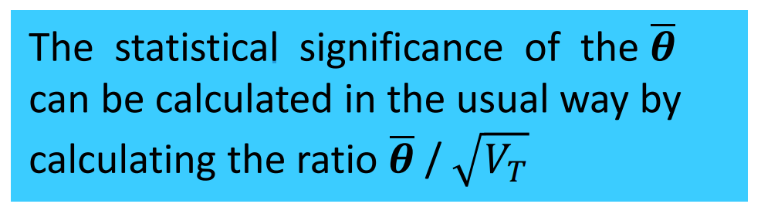

Multiple Imputation Method
3. Pooling Phase
How to combine the different results?
Pooling point estimate
Take an average of the parameter estimates across m datasets
Pooling standard error
Rubin’s Rules:
$$\overline{θ}=\frac{\sum_{1}^{m}{\hat{θ_{i}}}}{m}$$

Slide 49
Practical Issues & Myths

Slide 50
Practical Issues & Myths
Is imputation making up the data?
Not really!
The goal of imputation is not to produce the individual values and treat them as real data, but to estimate the population parameter and “preserve important characteristics of the data set as a whole (Graham, 2008).”
Account for uncertainty associated with missing data.
Thus, unbiased estimates can be obtained.

Slide 51
Practical Issues & Myths
Should both independent variables and dependent variables be included in the imputation model (MI)?
Yes
At least, all the variables that you will use in your analysis should be included.
Why? When the DV is not included, the correlations between it and IVs are assumed to be 0.
Excluding it will reduce its relationships with other variables.
Taking a liberal approach for variables selection in the imputation phase.
Programs did not distinguish whether a variable is IV or DV!

Slide 52
Practical Issues & Myths
Why including auxiliary variables?
Inclusive Analysis Strategy
ML and MI require MAR and since there is no test for MAR, we need to find ways to increase the likelihood to satisfy MAR.
Shafer and Graham (2002, p, 173): collecting data on the potential causes of missingness “may effectively convert an MNAR situation to MAR ”.
Incorporating a number of “auxiliary variables” helps by increasing statistical power or reduce biases in parameter estimates.
Use as many as you can, most useful are those with correlations ± .40

Slide 53
Practical Issues & Myths
What if my missing data is MNAR?
Using Selection Modeling & Pattern Mixture Modeling
(Chapter 10 in Ender’s Applied Missing Data Analysis)
These two models deal with the NMAR situation by statistically modeling the missing data mechanism.
Enders, C. K. (2011). Missing not at random models for latent growth curve analyses. Psychological methods, 16(1), 1.

Slide 54
Practical Issues & Myths
What should I report when I write it up?
Missing data mechanisms
Percentage of missing for each variable & overall percentage of missing
Software for missing data imputation
Imputation method & algorithm
Number of imputed datasets
The variables used in the imputation model

Slide 55
Multiple Imputation in R

Slide 56
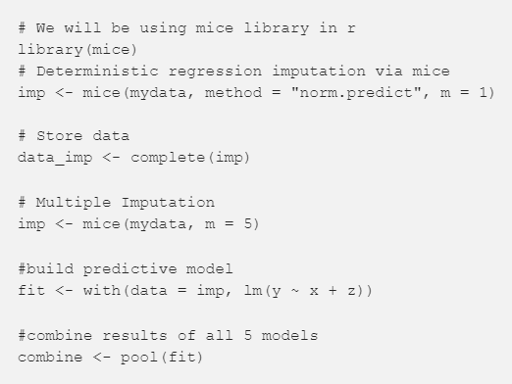
Example in R
`mice` package to run linear regression with 5 imputed dataset

Slide 57
Example in R
Example walkthroughs
‘Data Science Plus’
Simple Approach
Fuller Approach
Firouzeh Noghrehchi (2015)
Missing Data Analysis with `mice` Lab

Slide 58
References

Slide 59
References
Enders, C. K. (2010). Applied missing data analysis. Guilford Press.
Graham, J. W. (2012). Missing data : analysis and design. Springer.
Graham, J. W. (2009). Missing data analysis: Making it work in the real world. Annual review of psychology, 60, 549-576.
Pigott, T. D. (2001). A review of methods for missing data. Educational research and evaluation, 7(4), 353-383.
Schafer, J. L., & Graham, J. W. (2002). Missing data: our view of the state of the art. Psychological methods, 7(2), 147.
Azur, M. J., Stuart, E. A., Frangakis, C., & Leaf, P. J. (2011). Multiple imputation by chained equations: what is it and how does it work?. International journal of methods in psychiatric research, 20(1), 40-49.
Puma, M. J., Olsen, R. B., Bell, S. H., & Price, C. (2009). What to Do when Data Are Missing in Group Randomized Controlled Trials. NCEE 2009-0049. National Center for Education Evaluation and Regional Assistance.
IBM SPSS Missing Values 21 & 24 (user manual).
Buuren, S. V., & Groothuis-Oudshoorn, K. (2010). mice: Multivariate imputation by chained equations in R. Journal of statistical software, 1-68.

